Slide 1
A Mobile-based Student Essentials Application for Students of Columban College Inc.
A proposed system by: LESTER JOHN PULANCO

Slide 2
Analysis
It will depends on the features of the Mobile Application on how is the process of the current system works. For example in Timetable Maker. The students will list down and create a table for scheduling things or events. Each of the features of this Mobile Application has its current normal situation.

Slide 3
Objectives
To create an alternative mobile application for Students.
To have a mobile application with different student essentials like Timetable Maker, Grades Calculator, Scientific Calculator or even E-Notebook.

Slide 4

Usecase Diagram
Login
Register
Viewing of Features
Can search apps
Can use the full features

Slide 5
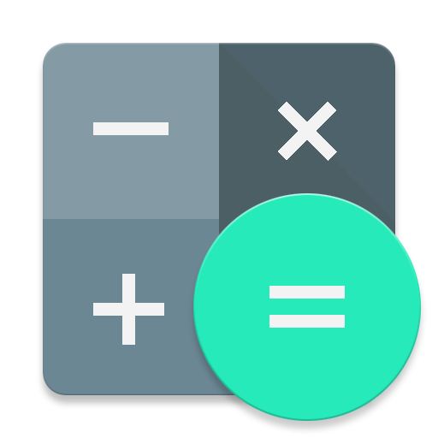




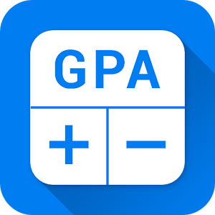
How does the system works?

Slide 6
Theoretical Framework
Input | Process | Output
Mobile Development Tools Database Xamarin Studio | - Applying the collected data and implementing it to develop the application needed. | Mobile-based application

